Slide 1
Pulse Market Update
James Maguire
Pulses UK President
Notes:
- Explain a bit about Pulses UK & Who I am / members etc

Slide 2
Pulses UK – What do we do?
Increase production of UK grown pulses
Liaise with government & policy makers to ensure pulses are considered along side all other more mainstream crops
Ensure industry is aware of all advantages and uses for UK grown pulses

Slide 3
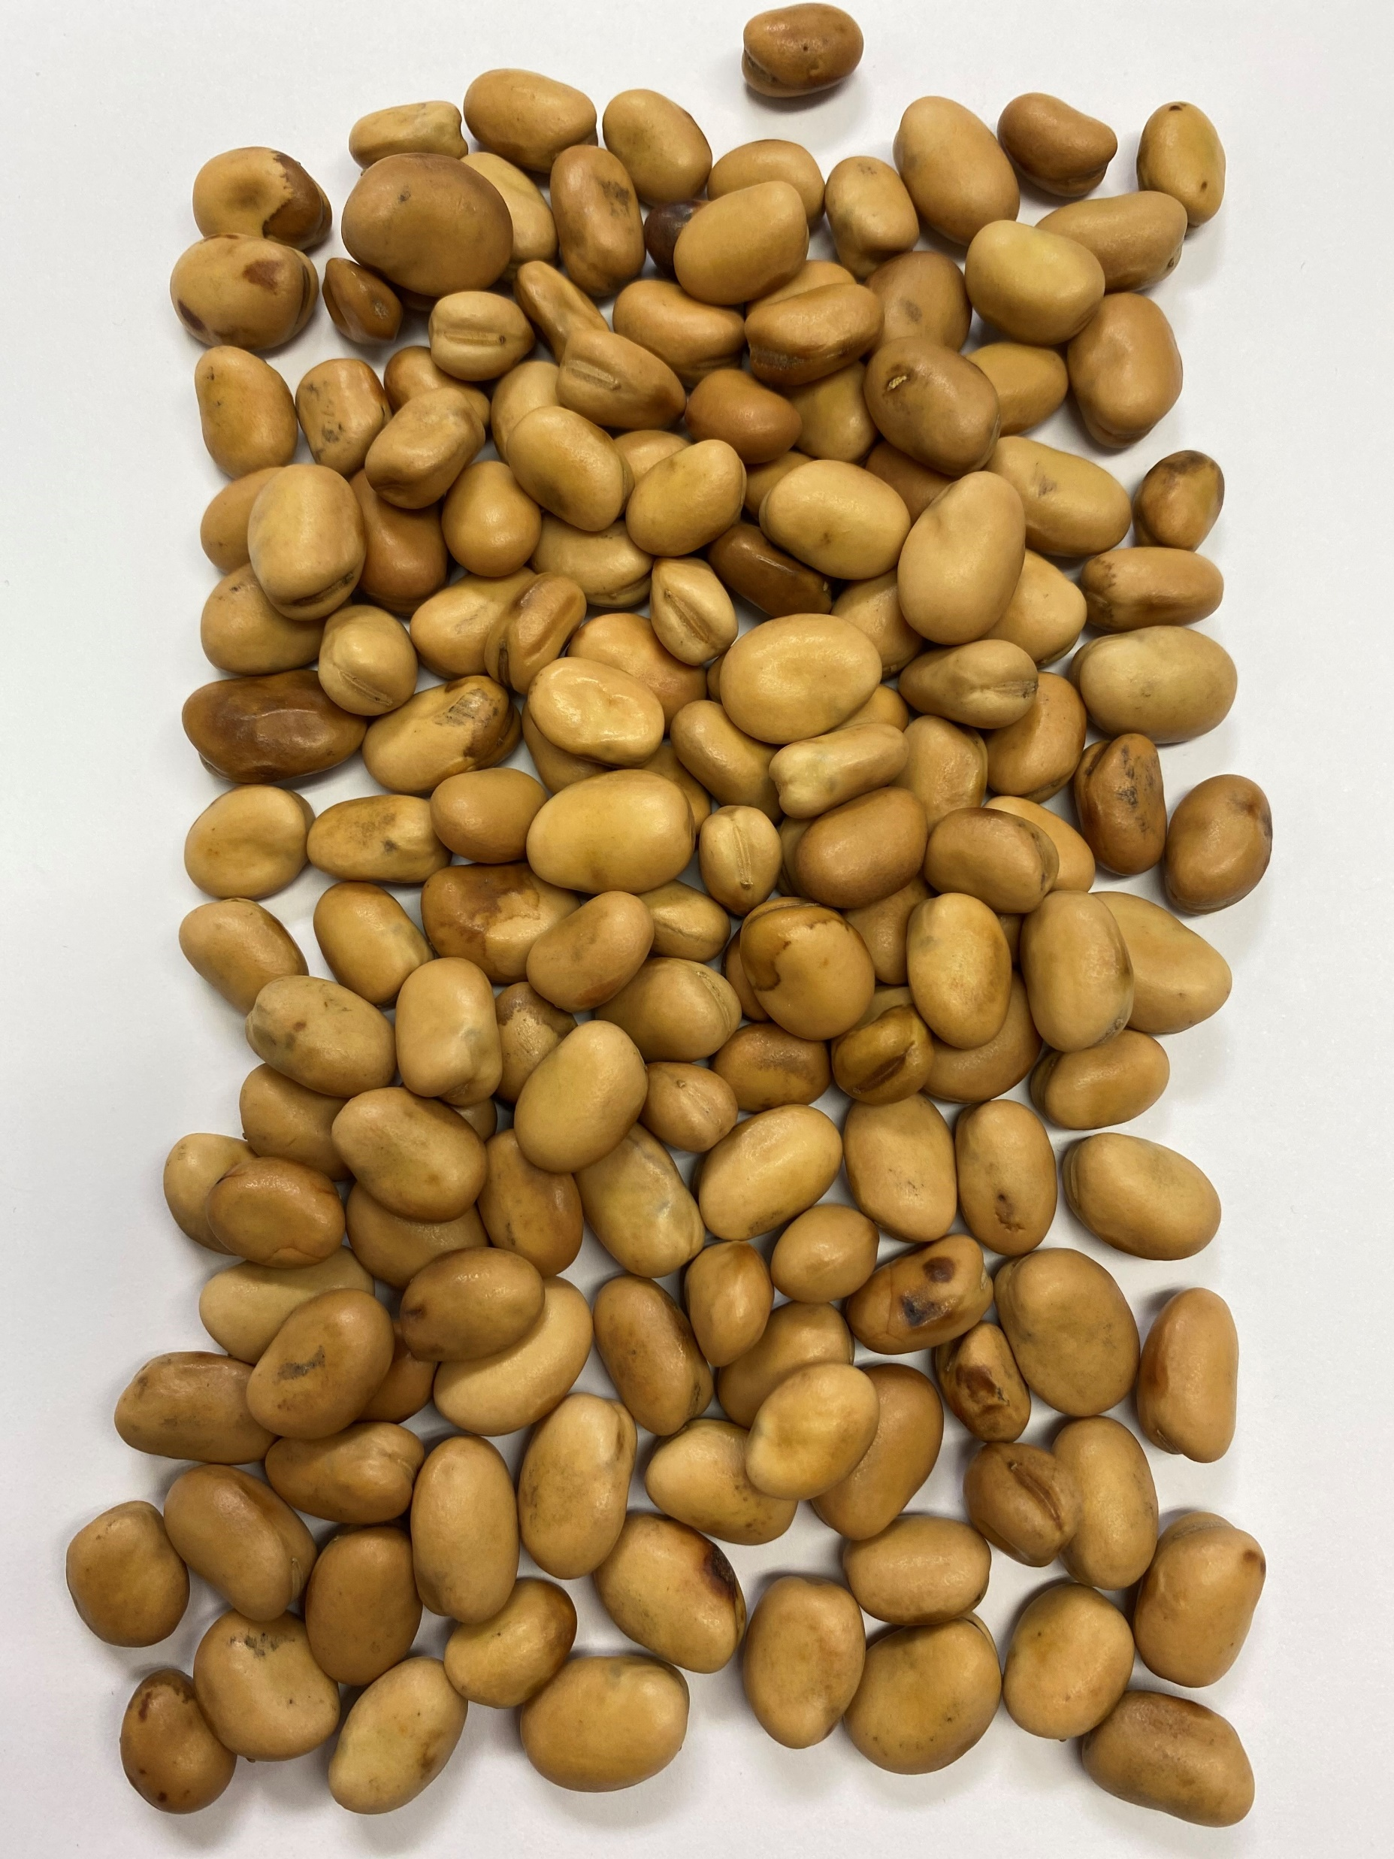
Bean Markets
Notes:
UK crop 40% winter sown and 60% spring
Yields very variable ranging from 2.5 to 7.5 tn/ha

Slide 4
Bean Supply
Figures from from Defra and Frontier
Notes:
Feed beans are used in ruminant and pig rations
Poultry rations use a cooked product of 50% beans and 50% whole rapeseed
Aquaculture is growing in demand esp for dehulled beans
Human consumption demand is all in Egypt and Sudan
UK quality is difficult to achieve due to weather and insect activity
Feed exports from the UK usually into S Europe and recently more into Holland and Denmark

Slide 5
Bean Distribution Old Crop
Baltics: Supply down by up to 50%.
Australia: Good crop expected + carryover from last year.
France: Lower yields.
Legvalue, 2020
Notes:
OC
Yields were good with approx. 4.0mt average,
Looking at 30% of the crop being of HC quality, 680,000 to 750,000 tonnes in the UK.
The lower quality and yield in the Baltics leading to the rally in base price as demand from Egypt has been good
.
Australian beans are now replacing UK supply into North Africa as they have had harvest. As a result HC markets are difficult to find (speak to your local merchant)
Feed prices are around £260 deld but again speak to your local merchant

Slide 6
S&D
 | Harvest 17 | Harvest 18 | Harvest 19 | Harvest 20 | Harvest 21 | Harvest 22
Stock​ | 0 | 39 | 0 | 20 | 9 | 29
Area 000’s Ha​ | 180 | 155 | 135 | 179 | 185 | 200
Yield t/ha​ | 3.9 | 2.85 | 4.2 | 2.9 | 4 | 3.57
​ | ​ | ​ | ​ | ​ | ​ | ​
Supply 000’s tns​ | 702 | 481 | 567 | 539 | 749 | 743
​ |  | ​ | ​ | ​ | ​ | ​
Feed UK | 307 | 240 | 180 | 288 | 300 | 300
Seed +Farm feed ​ | 100 | 5 | 120 | 80 | 70 | 70
Export Feed​ | 130 | 100 | 175 | 110 | 100 | 150
Export HC | 120 | 60 | 75 | 45 | 100 | 200
​ |  | ​ | ​ | ​ | ​ | ​
Demand 000’s tns​ | 657 | 405 | 550 | 523 | 570 | 720
Surplus 000's tns | 45 | 75.75 | 17 | 16.1 | 179 | 23
Adapted from Frontier, 2021
Notes:
SUPPLY – looking forward to this spring…
Winter bean area static and similar to last year
- Spring bean seed supply is good, but commodity prices for S barley is so high we may find the area for spring beans is under pressure
Prediciting an increase in bean area up to 200,000 ha (break crop option)
Prices available of around £30 over FW futures, FW historically high
DEMAND –
Increase in Export demand for both feed & HC (both export markets)

Slide 7
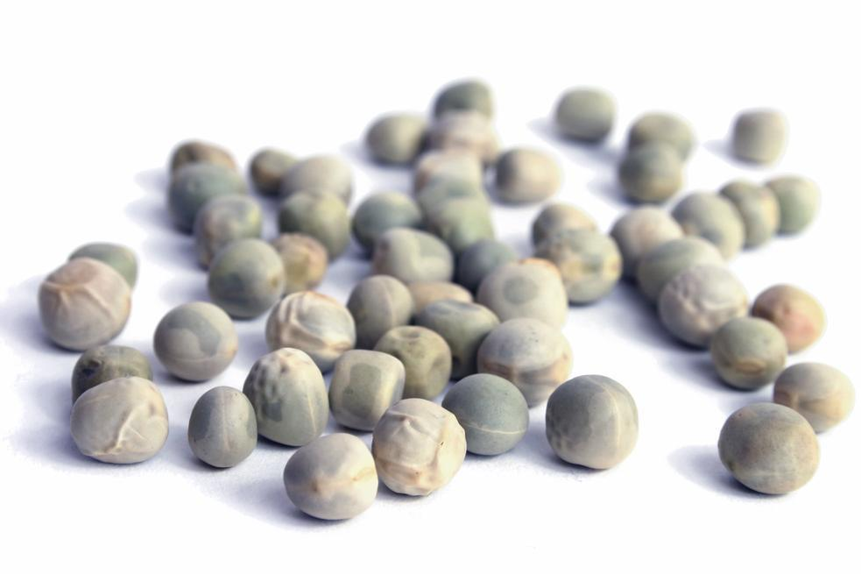
Pea Markets

Slide 8
Pea Supply
Defra figures – Historical production
Notes:
OC
Green- £280 ex good quality
Yellow- Limited market, may be traded out due to lack of trades? - £300 ex last trade but it was a while ago
Maple- £350 ex ballpark, but hard to find a market. A job for local merchants
Marrowfat- Very little left on farm, open market indicated mid £400 s but could be more perhaps?

Slide 9
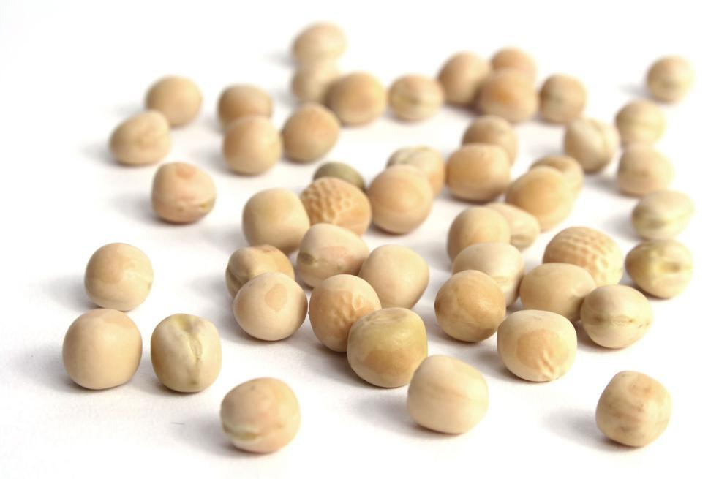
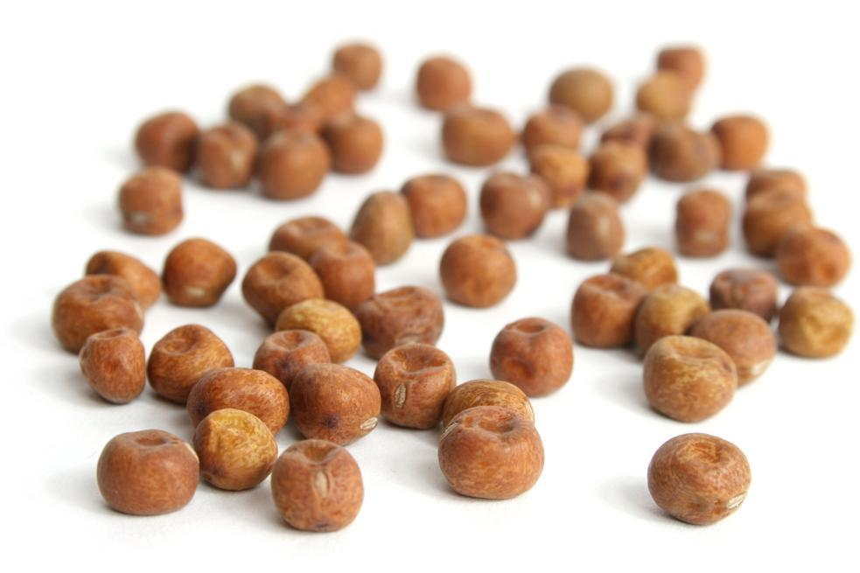
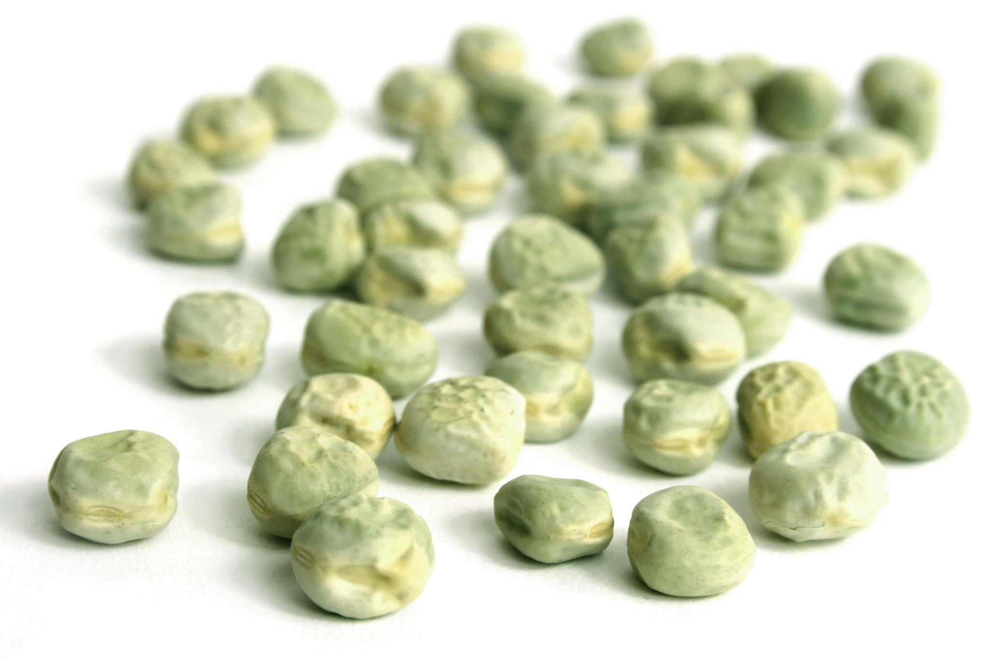
Pea Supply H2022
Green Peas
30000 ha grown
Yellow Peas
6000 ha grown
Maple Peas
3000 ha grown
Marrowfat Peas
5000 ha grown
Notes:
AREAS first, then prices
NC
Green - £275 ex fixed or Min / Max contracts
Yellow - £20-50 discount to Green peas depending on location and individual markets (smaller market more niche)
Maple - £350-400 values heard, again speak to local merchants
Marrowfats - £400 contracts available, 5% bleached clause, fallbacks on a sliding scales given also
Small area, niche crop compared to WW or Sbarley, enquire sooner rather than later for contracts as they will run out early and seed will be tight.
But certainly strong demand in the sector and seed may well be tight for the newest high yielding varieties
SO that concludes my market update today, if you have any questions pleas feel free to ask now

Slide 10
Questions

