Slide 1
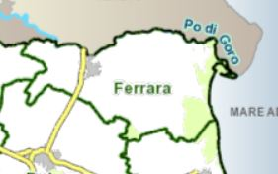
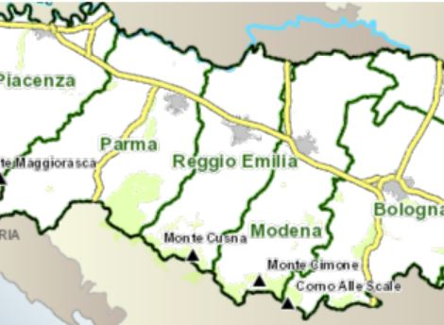
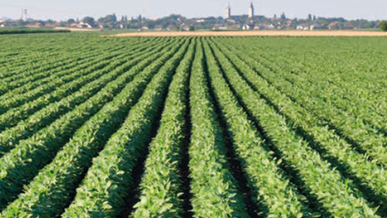
7th AIEAA Conference
Evidence-based policies to face new challenges for agri-food systems
June 14-15, 2018 – Conegliano (TV), Italy
Identification of levers for EU and national policies to facilitate the development of legumes in Europe
Chatzinikolaou P.¹, Galioto F.¹, Zavalloni M.¹, Raggi M.², Viaggi D.¹
¹ Department of Agricultural and Food Sciences, University of Bologna, Bologna (Italy)
² Department of Statistical Sciences, University of Bologna, Bologna (Italy)
INTRODUCTION AND OBJECTIVE Legume crops are a significant component of the human diet and animal feed and have an important role in the environment. Their production provides multiple environmental benefits to agricultural landscapes in Europe, increases resource efficiency, and contributes to balancing Europe's deficit in plant protein production. A range of policy instruments to support legume production has been introduced the last years in the EU and there are early indications that the trend in the decline in the production of legumes has been reversed. The objective of the study is to investigate current policy settings influencing the production of legumes in Europe with the aim to identify potential policy needs, simulate selected alternative policy design options and identify good practices and recommendations on prospective policy measures: Factors influencing the development of legumes in Europe Policy priorities justifying the need to improve the cultivation of legumes in Europe Instruments needed to achieve expected policy goals on legumes
FACTORS AFFECTING THE CULTIVATION OF LEGUMES IN EU | REVIEW OF EU POLICIES RELEVANT TO LEGUMES Subsidies to competing crops Greening under the reformed CAP Coupled support in the current and reformed CAP Support to sustainable farming practices involving legumes Environmental, energy, health or trade policies The introduction of agricultural practices like greening measures, direct subsidies and ecological focus area obligation, seems to have had positive effects on protein crops that are expected to expand relative to their long-term trends.
CASE STUDIES
Two existing value chains, in the region of Emilia-Romagna, selected to cover the diversity of feed and food uses including innovative processes. The features of the value chains were evaluated and reviewed using interviews to farmers and other actors of the value chain, trying to define their knowledge, benefits and constraints experienced in developing the market.
The value chain is on soybean production, mainly used for oil extraction. The case study is working with the Cooperative Terremerse, in order to follow up its producers from production planning to marketing, and guarantee constant supplies in terms of volumes and specific quality characteristics. | The value chain on alfalfa production, used for dairy cattle feeding for Parmigiano-Reggiano cheese production. The goal is the production of high quality forage, for the production of milk in line with production specifications that determine the unique quality of Parmigiano-Reggiano cheese specifically for long maturation.
Market conditions
Price volatility
Health impact and dietary change
Agro-environmental aspects
Biodiversity and soil fertility
Use of fertilizers, pesticides and gas emissions
Variability of grain yields
SWOT analysis on the soybean value chain
Strengths Certifications productions (2BSvs Std.01) Soil fertility High adaptability in rotations Relatively low land management cost | Weaknesses Yield variability High seed prices
Opportunities Control imports GMO free Zootechnic sector /press cakes EU biofuel market / RED Directive | Threats Imports of GMO soybean International market prices Minimum policy awareness in the food soybean industry
SWOT analysis on the alfalfa value chain
Strengths Contribution to the quality and excellence of the final product Soil fertility | Weaknesses Geographical barriers Cultivation limited to the livestock farming
Opportunities Norms of production specification Continuous expansion in foreign markets | Threats Low prices of other types of forage (silage) Low prices of milk for the production of high quality cheese
NEXT STEPS
IDENTIFY THE IMPACTS OF THE POLICIES RELEVANT TO LEGUMES: Expected results will involve a description of the different policy components, of their contents, of the type of policy instruments used, of their interactions and of the implementation strategy. Improved policy measures to support legume development will be identified working at different scales from farm to EU and including a wide range of policy areas (e.g. direct incentives to farmers, cross compliance and greening, innovation measures, agri-environmental schemes).
This project has received funding from the European Union’s Horizon2020 research and innovation programme under grant agreement n⁰ 727672.

